Slide 1
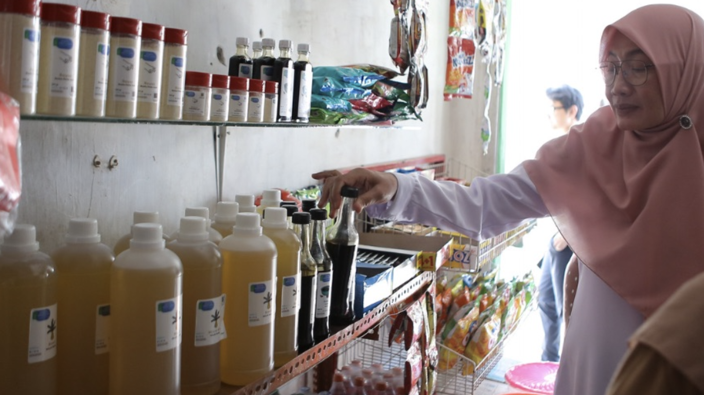
PISCES Initial Reuse Pilot
Pilot Final Report
Enviu Indonesia | June 2024

Slide 2
Overview
Introduction
Overview of scoping questions
Products to include in the pilot
Demography, pilot location, communities
Consumer Behaviour including sales data
Logistics
Conclusion and learnings

Slide 3
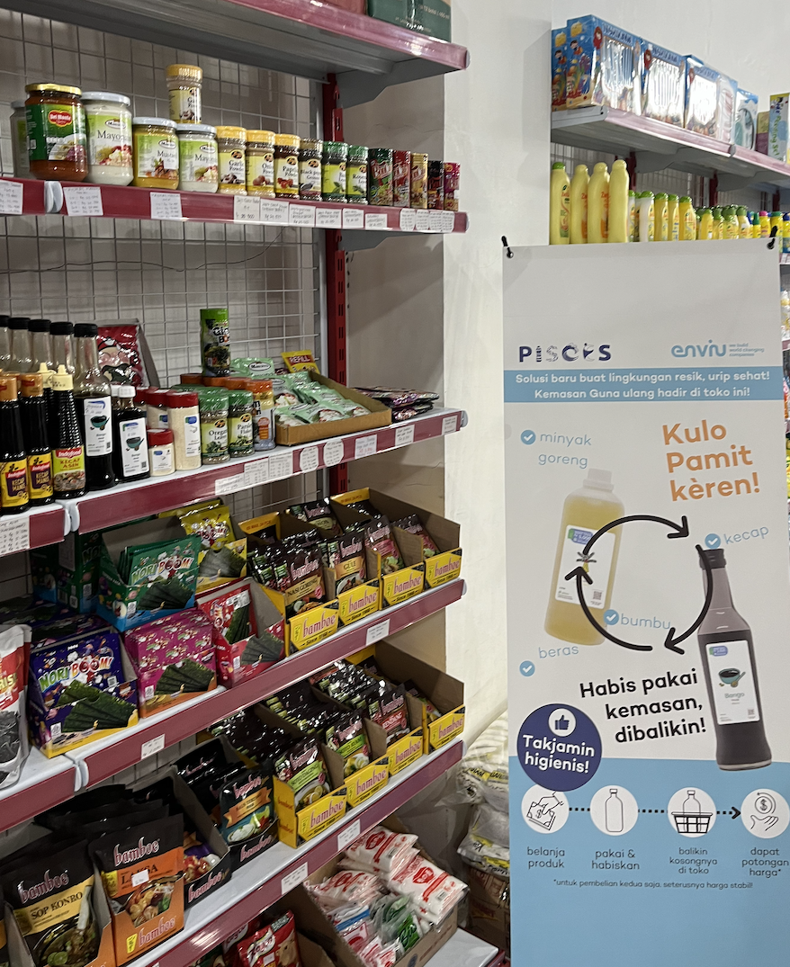
Introduction
Both PISCES and Enviu share the ambition to eliminate plastic pollution in Indonesia. Enviu works on this objective via its venture building activities in its Zero Waste Living Lab program. The Zero Waste Living Lab program was started in Indonesia in 2019 and has since worked on a total of 10 business ideas out of which 4 are currently active ventures. All our Indonesian businesses are focused on prevention of plastics at the source, via either reduction of new delivery systems, such as reuse and refill models for packaging of daily goods and needs. The Zero Waste Living Lab program is currently focused on the Greater Jakarta area.
Both PISCES and Enviu see the opportunity in reuse and refill solutions. If implemented well, these solutions could eventually reach a 40% reduction in plastic pollution in large parts of Indonesia on the longer term. Therefore, PISCES has asked Enviu to join its partnership and to implement the Zero Waste Living Lab approach.
This report is the final learning summary for our 2024 Reuse Pilot project in the Banyuwangi area. The pilot started half February 2024 and lasted until the end of May 2024.

Slide 4
Overview of scoping questions
Based on the Pilot Proposal Document, the following questions are used to scope the Reuse Pilot in Banyuwangi
Products to include in the pilot:
Which FMCG’s are committed to include reuse in the region?
Which departments of these FMCG’s are included (e.g. quality team, branding, etc.)?
What is the top 10 of packaging items from products (from which FMCG’s) that are being mismanaged in the region?
With which products can we start a pilot (combining the FMCG commitment, most impact in terms of replacing current mismanaged packaging and availability in reuse model)?
Demography, pilot location:
What does the demography look like on average in the region?
What does this mean for consumption patterns?
Where are most packaging items mismanaged so most littering can be prevented?
Consumer behaviour:
Product usage:
Which size of packaging items from the chosen products (see above) is used most?
How often do consumers go for the next buy of the product?
How do they see the cashback system?
Which zero waste solutions are already in place in the area?
Which types of consumers are being exposed to these solutions?
Which types of retailers are being exposed to these solutions?
Committed communities / retailers:
With which communities in the chosen location (see above) are already ongoing collaborations? Waste banks, PKK, other?
With which other retailers (various types of warungs) are already ongoing collaborations?
Logistics:
What logistics parties are available in the chosen area?
What zero waste emissions logistics parties are available in the chosen area?
What other infrastructure parties are available in the chosen are?

Slide 5
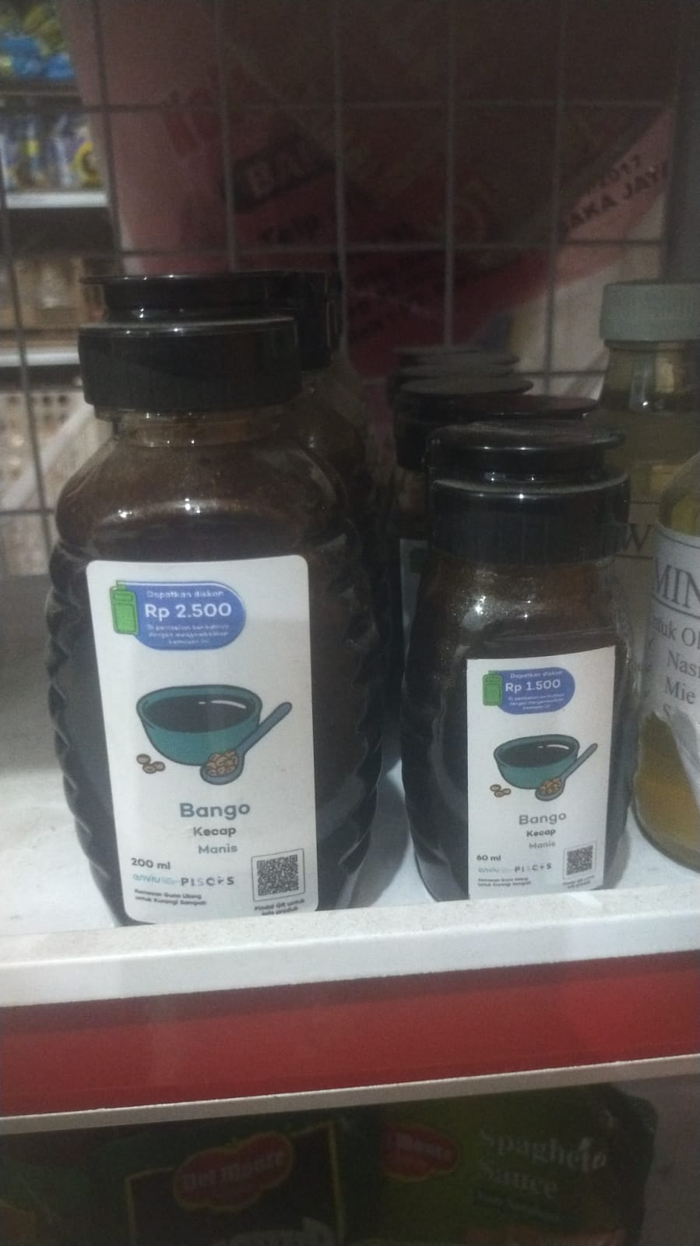
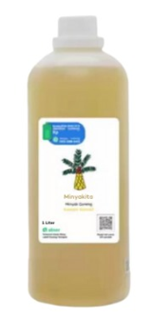
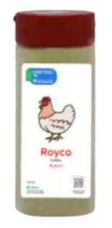
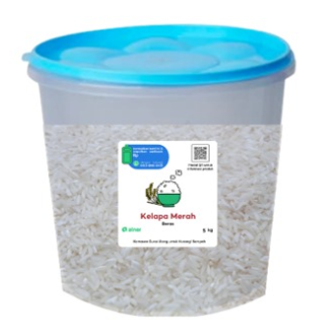
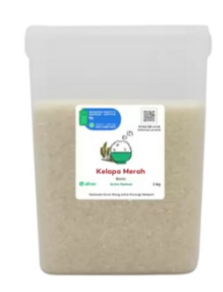
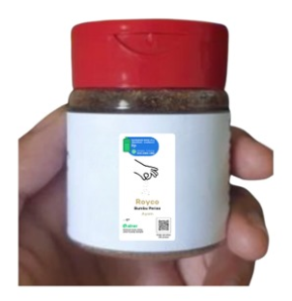
Products to include in the pilot
With which products can we start a pilot (combining the FMCG commitment, most impact in terms of replacing current mismanaged packaging and availability in reuse model)?
  Rice, Soysauce, Spices and Cooking oil
Which FMCG’s are committed to include reuse in the region?
  Rice: Kelapa Dua, Banyuwangi Based Rice Mill -> Committed to sustainability including reuse and want to explore
  Soysauce: Bango, Unilever -> Informed and allow us to do research.
  Spice: Bango, Unilever -> Informed and allow us to do research.
  Cooking Oil: Bimoli and Minyakita -> Informed, piloting informally via their distributor
Which departments of these FMCG’s are included (e.g. quality team, branding, etc.)?
  As of now, at the Rice mill we work with the owner and operations team. The other FMCG partners are aware of the pilot and allow us to do research and to work informally with their distributors. We can explore the official partnership during the next scaling phase.
What is the top 10 of packaging items from products (from which FMCG’s) that are being mismanaged in the region?
  From PISCES research: sachets and within sachets category: coffee sachet, seasoning, sauces, nuts and crisps, noodles
SELECTED PRODUCTS OVERVIEW
2 kg
5 kg
1 L
150 gr
60 gr
200 ml
60 ml

Slide 6
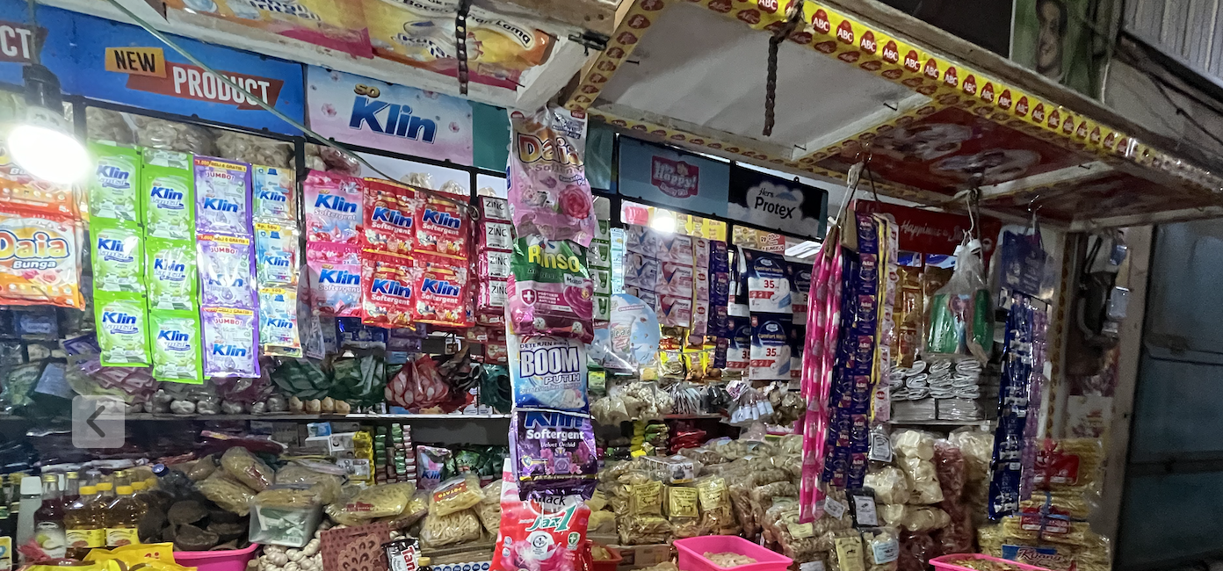
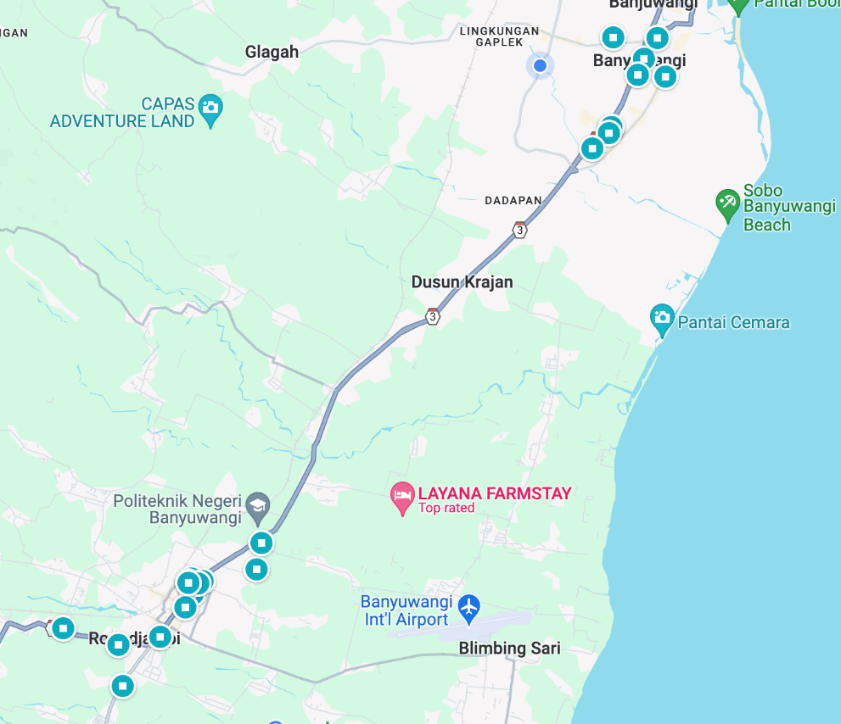
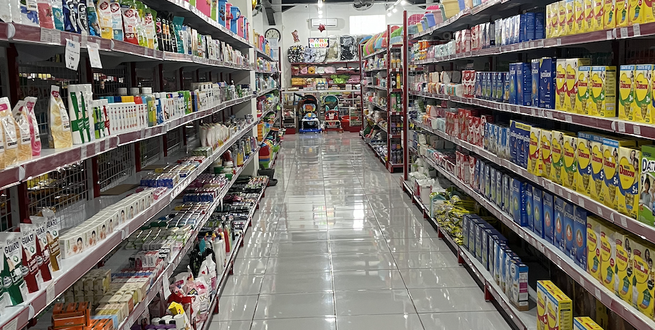
Demography, pilot location, communities: initial scoping
On Demography and Merchants:
What does the demography look like on average in the region?
  Our B2B merchant partners are divided into two types: the Warung and Supermart. The Warung caters middle to low-income consumers, and Supermart caters the middle to upper-income level demographic of Banyuwangi
What does this mean for consumption patterns?
  The nature of the products are fast consumption and convenience. Price sensitivity and brand trust are high within this demographic.
Where are most packaging items mismanaged so most littering can be prevented?
  For now, we found that cooking oil is the fastest selling within the merchant type. From the litter surveys in the Banyuwangi area it was found that also seasoning sachets and sauce sachets are found often. Replacing these via returnable packaging systems will prevent most littering. We also found out that other items might need to be included in future pilots, such as coffee sachets or snacks packaging.
Committed communities / retailers:
With which communities in the chosen location (see above) are already ongoing collaborations?
With which other retailers (various types of warungs) are already ongoing collaborations?
  See the overview below for the answer to these 2 questions:
Banyuwangi City
During the pilot preparation in February 2024 we spoke at length to 20 Merchants:
15 Traditional warung Kelontong (including 1 PKK)
5 personally owned semi-supermarket
75% (15 stores) is willing to discuss reselling (and provided contact details)
In the 2nd week of January, we conducted surveys in stores throughout Banyuwangi City and the Rogojampi area.
6 stores agree to pilot with us by the end of February 2024(30% of the total merchants reached):
3 Warungs, 2 PKK warungs, 1 Supermart
Traditional Warung Kelontong
Peronally owned semi-supermart
Rogojampi Area

Slide 7
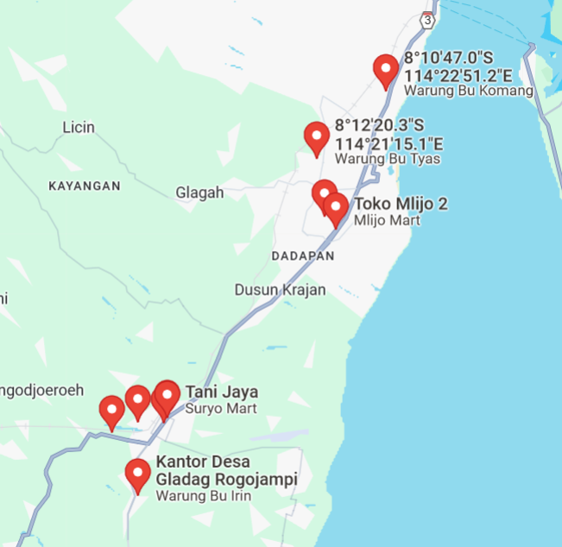
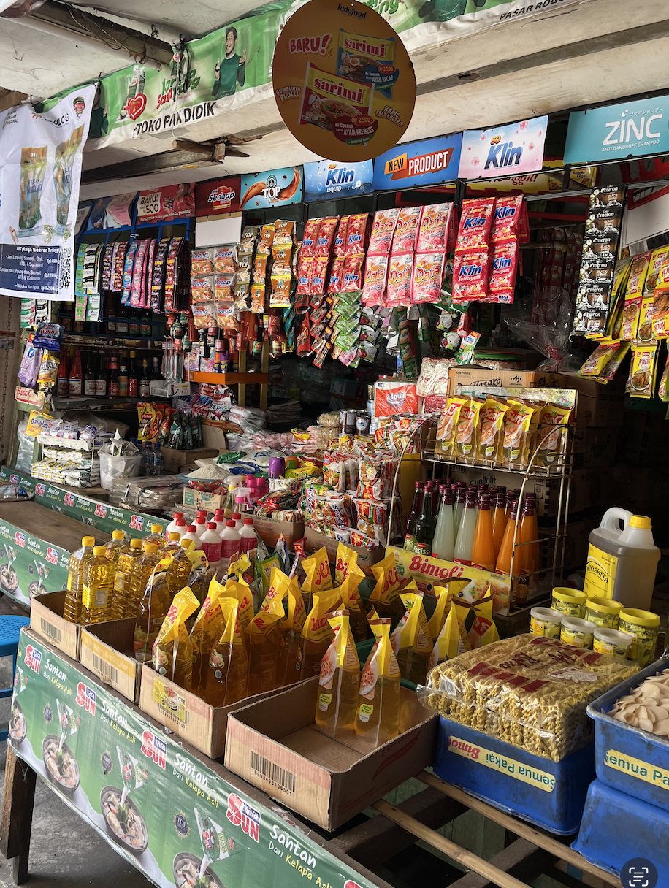
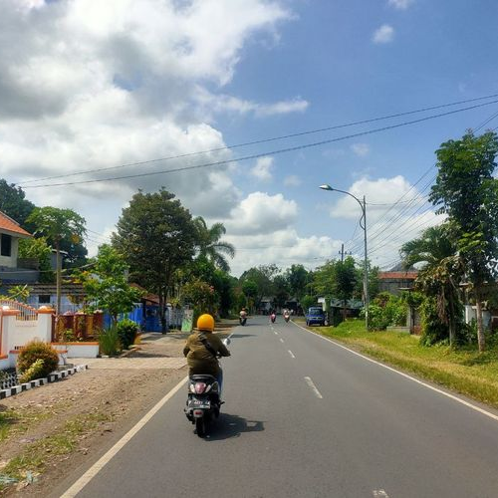
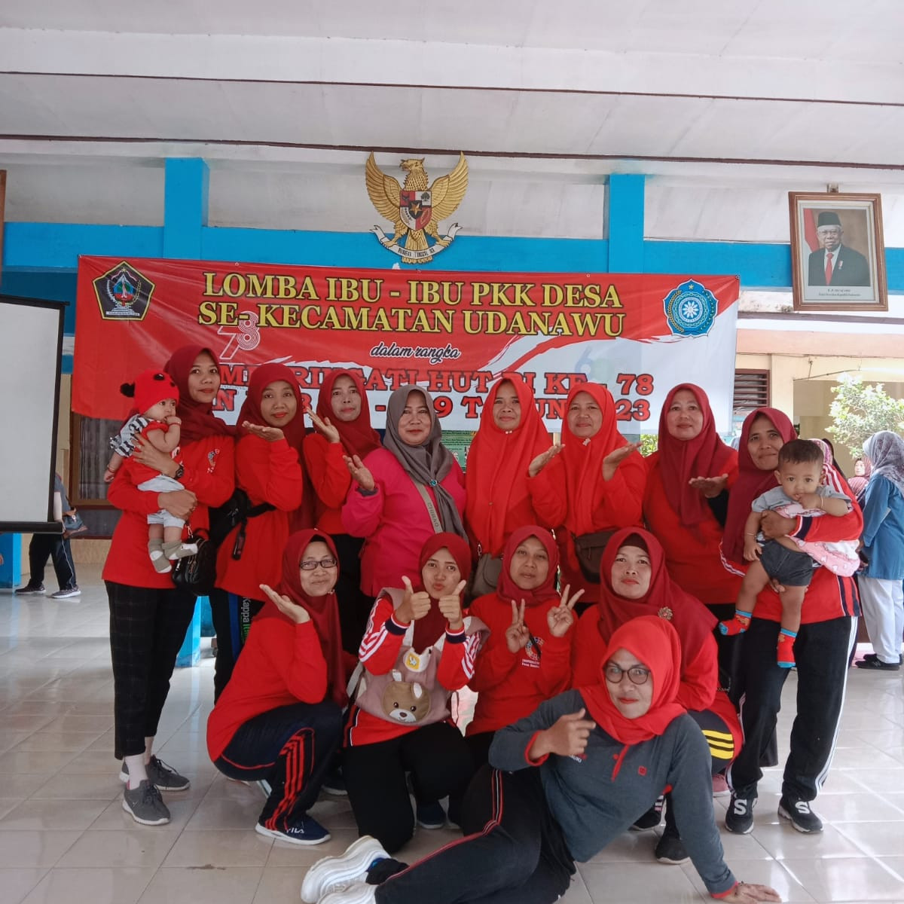
Final Pilot Location Overview
The Core Elements of the Merchant-Solution Fit:
Banyuwangi City
Sells the fasting period products (rice, oil, sauce)
Within proximity of the Living Lab
Have high foot traffic, accessible, regular consumers
Plus: owned/ connected to local community (i.e PKK)
Started with 7 stores in February 2024
In June, we’re in 12 stores! That’s 71%!
6 Warungs, 5 Community partner, 1 Supermart
3/11 stores are organic growth
We have 12 Stores selling our reusables!
Rogojampi Area
Map link: https://maps.app.goo.gl/zTHhUpJ3J5AoM7ZX6

Slide 8
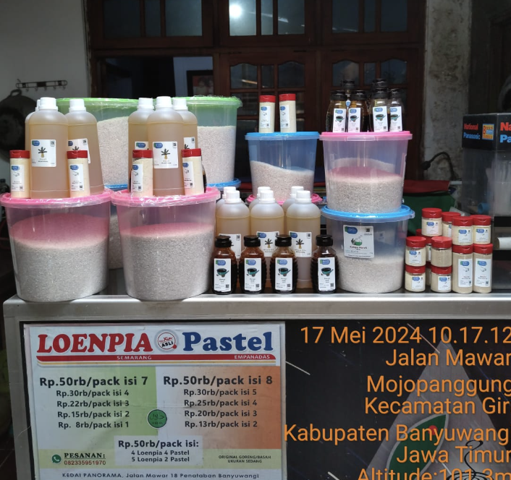
Consumer Behaviour
Which size of packaging items from the chosen products is used most?
  Cooking oil is best-selling, followed by rice
How often do consumers go for the next buy of the product?
  Fastest a week for rice and cooking oil
How do they see the cashback system?
  A hassle at first, need a lot of convincing
  Need a lot of discount first
Which zero waste solutions are already in place in the area?
  None
  In Osoji, they make their own zero waste items (e.g Soap)
Which types of consumers are being exposed to these solutions?
  Woman, 30-50 years old, Socio-economic B-C
  It is proven that price convenience is key and also stores like Mlijo who has regular buyers helps to gain consumers
  Consumers seem to return the packaging in 4th week
Which types of retailers are being exposed to these solutions?
  Independent Warung nearby houses having regular consumers has a higher chance of people buying
  Interested in our product mostly because of the price
  Interested also in the packaging , change of the kecap sauce is significant for sales interest
  4 Communities are interested because of environmental reasons

Slide 9
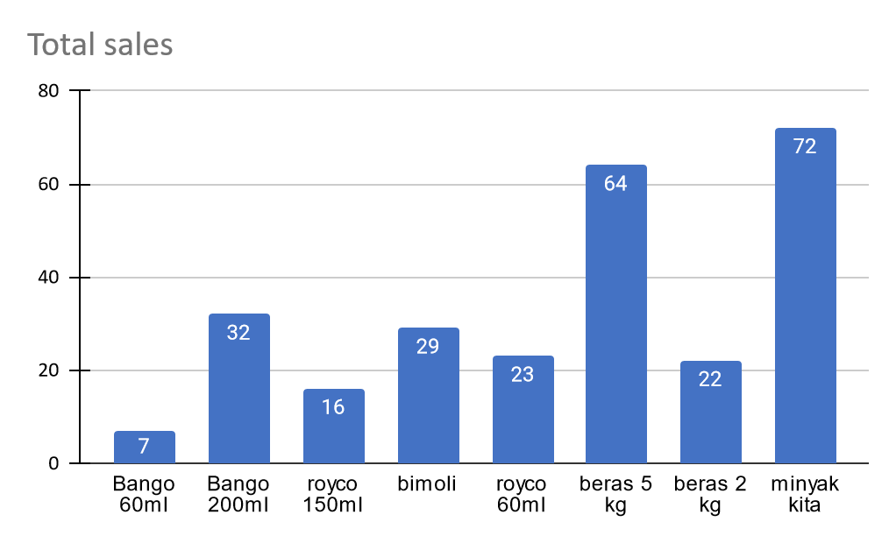
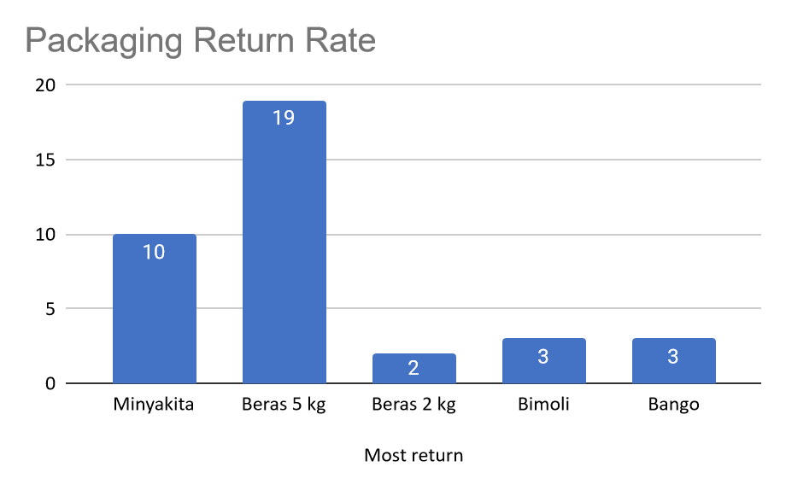
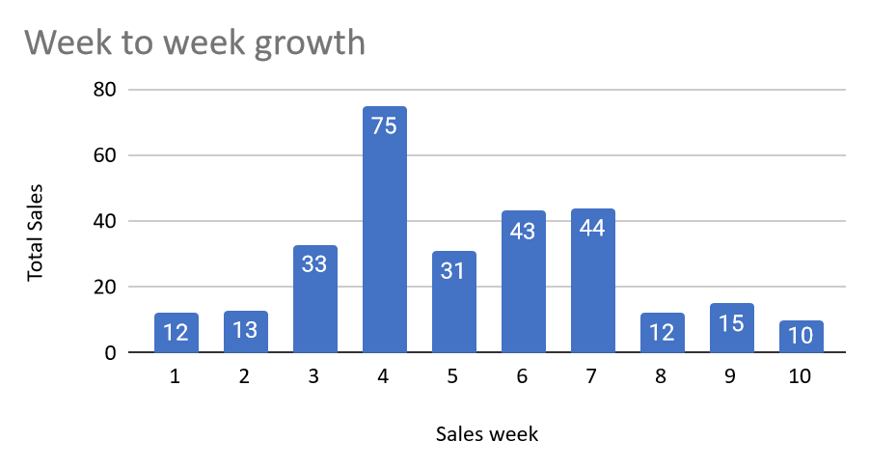
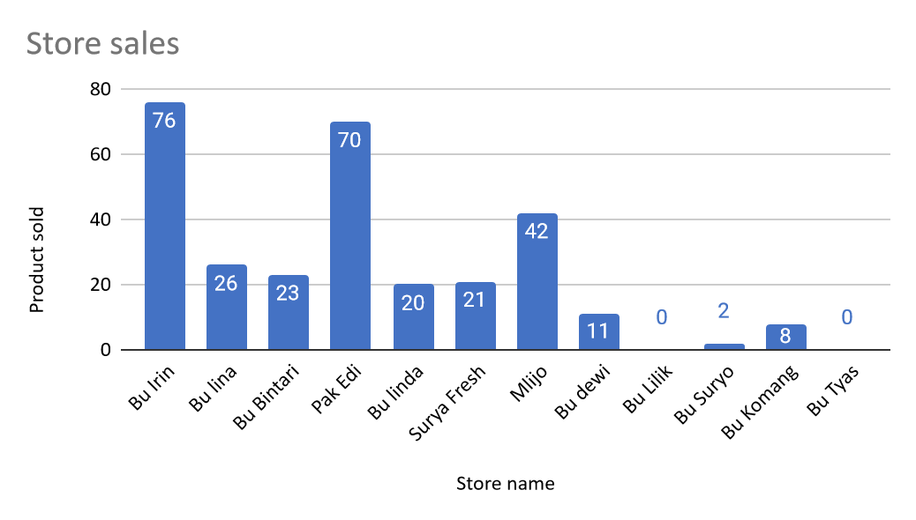
Consumer Behavior in numbers: Sales
We have sold 305 items in 11 weeks of sales!
Best Selling
2nd best sell
Sales report
Total product sold: 305 products
Total weeks selling: 11 weeks
Return rate: 13.1% (40 products out of 305)
Average weekly sales: 35 products
Average week on week sales growth: 33%
Best Selling: Cooking oil Minyak Kita
Best Selling store: Bu Irin & Pak Eddy
3rd
best sell
There’s a subsidized price from a government program in week 5 called “Pasar Murah” affecting the sales. Ramadan (and delayed data from the merchants) also affect the sales in week 5 until 7.
Community stores
Regular stores
Low sales early May are due to community stores not yet settling in after Eid, and and a lot of them are still out of town.
Other reasons for lower sales in end of pilot include: sellers are busy (especially community stores) with other jobs because Ramadan stops -> more hours, and even job replacements
This is eid week
Addition
to 2 stores

Slide 10
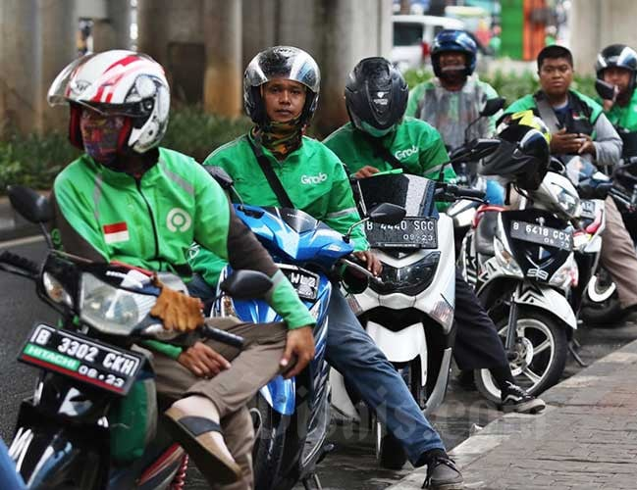
Logistics
What logistics parties are available in the chosen area?
  We will be using the existing internet-based motor hailing app (gojek and grab)-package sending feature as the courier to distribute the products to the merchants and to get back the empty returned packaging.
What zero waste emissions logistics parties are available in the chosen area?
  None as of yet.
What other infrastructure parties are available in the chosen are?
  PKK community, Dinkes Puskesmas (health) organizations are our current main contact for community hubs.

Slide 11
Conclusion and learnings
Regular Store
`
Community Store
Products:
Change of Soy sauce bottle improves the sales.
Consumers want other products in returnable packaging such as soap or detergent. Not having new products in near time demotivates them.
After purchasing, a lot of consumers use the packaging for storing snacks like kerupuk (for the rice packaging) and other liquid for other packaging.
Demography, pilot location:
Mostly women 30-50 years old with socio economic B-C.
Strong community focus: we were invited to join several community events during the pilot.
We’ve had an introduction with CLOCC to explore potential capacity building.
Seller learnings:
Gained two new stores in Banyuwangi City Area.
A famous store like Mlijo has their own loyal consumer pool so there's no high marketing effort but the sales are still high.
36% of sellers are community based and are organically grown.
Seller values capacity building activities, once not that "active", sales goes down.
Community store expect more locations and products, but our limited resources made it impossible to go to other regions within Banyuwangi area already.
Community sellers cannot always be relied on completely for data: sometimes they move to other regions or they are super busy, meaning they cannot keep track of the sales data.

Slide 12
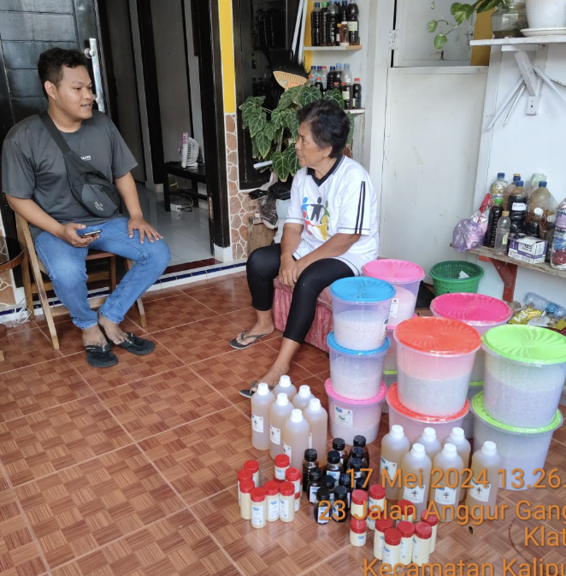
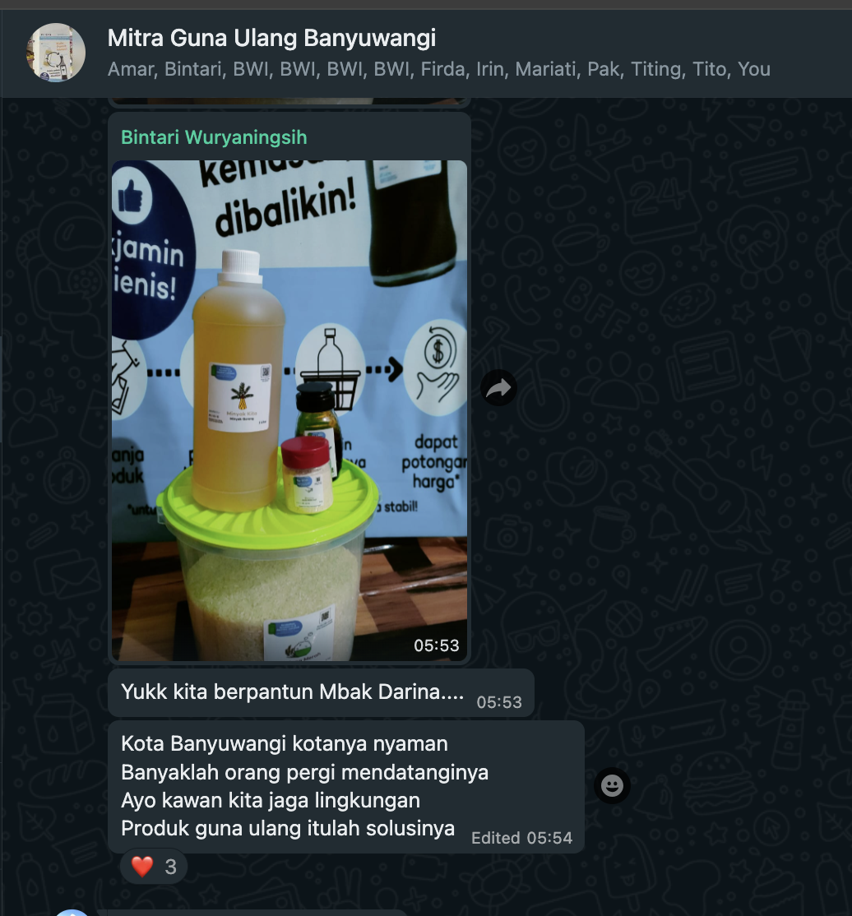
May Capacity Building with Community
Capacity building by sharing session with the two stores and their neighbors by our team, Amar
We have merchant group for support and information sharing!

Slide 13
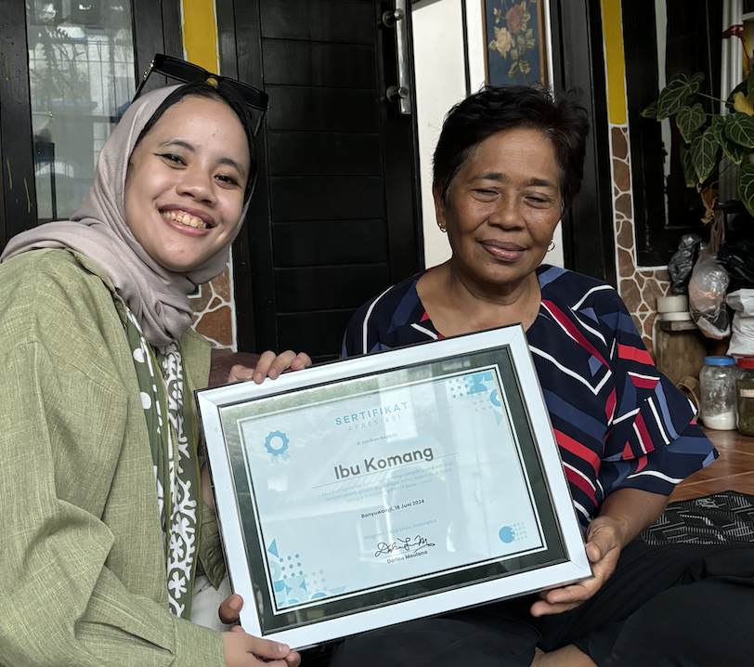
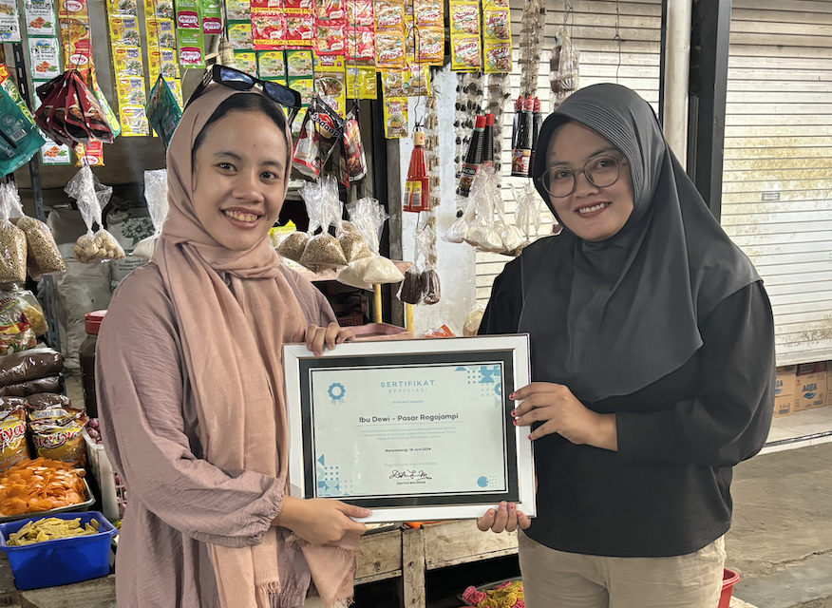
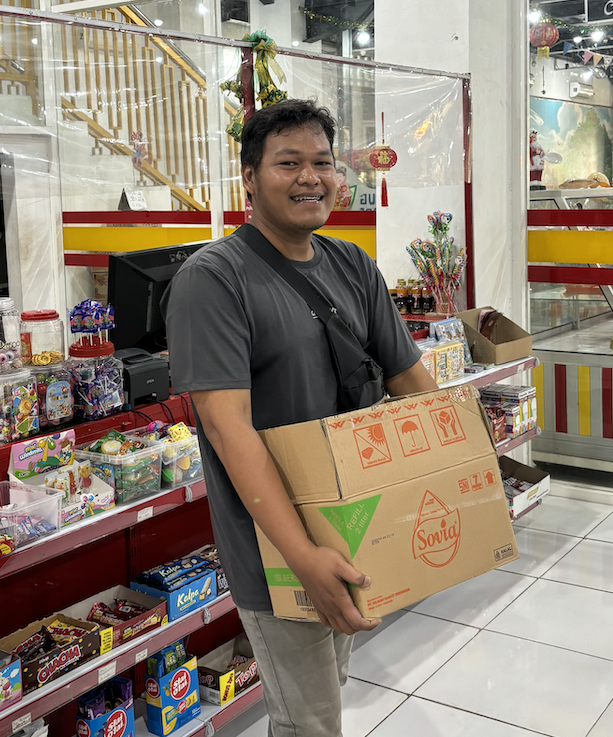
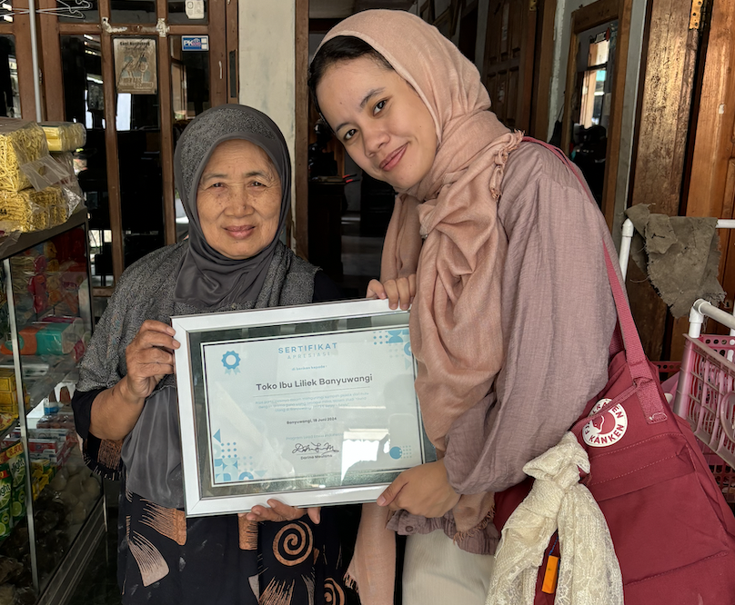
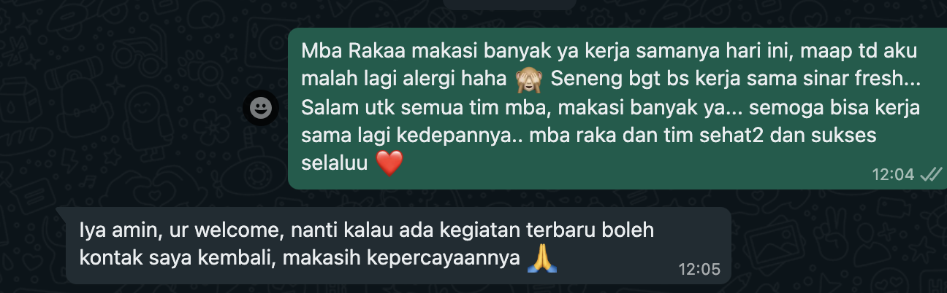
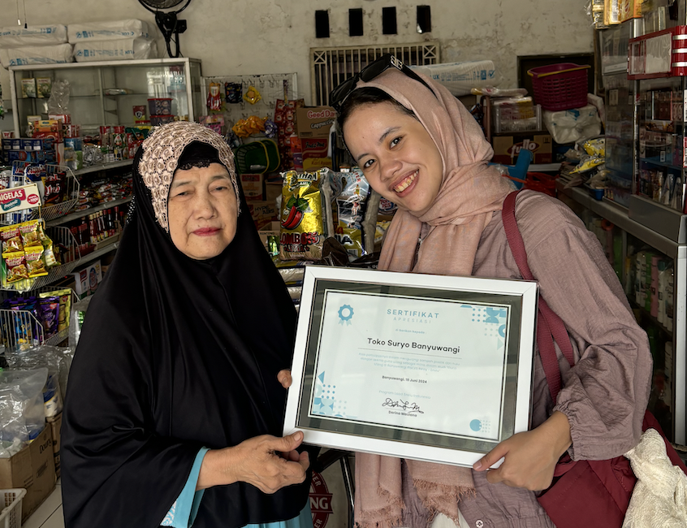
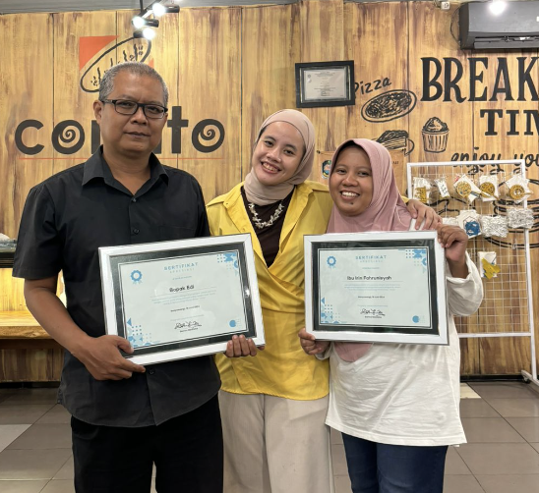
See you next time! Remarks in Pausing Pilot
We are so grateful for the opportunity for working with these amazing merchants, our hands-on changemakers.
80% of our merchants said that they’re really happy with the collaboration, look forward for continuation and really happy with our team.
Our approach is organic-engagement where we haven’t done big, extensive marketing due to budget constraints – but from here we see demand even for when the approach is organic. Our marketer Amar is very close to our merchants!
The 16% not wanting continue because of the idea, they love the environmental aspect and love working with our team, is just because of the demographic of their buyer of very low demographic consumer. (Liliek + Suryo)
"Once there's new program, we're happy to resell again. Thanks for the trust"
NEXT STEP
We wait for our funding, and our packages are stored at the PISCES office..
and in meanwhile, Systemiq offer to collaborate once September is ready, to integrate with their BUMDES, PKK, and Desa Capacity building Activities. Engaging with this Desa institutions will be a key as community merchant is very occupied with their work (busy).

